Slide 1
Data Analysis
With Matplotlib

Slide 2

Matplotlib
Matplotlib is python’s fundamental plotting library. It is extremely flexible and gives the user full control over all elements of the plot.

Slide 3
Plotting and Visualization
In : import matplotlib.pyplot as plt #calling with alias name
#running %matplotlib notebook in Jupyter
In : import numpy as np
In : data = np.arange(10)
In : data
Out : array([0, 1, 2, 3, 4, 5, 6, 7, 8, 9])
In : plt.plot(data)

Slide 4
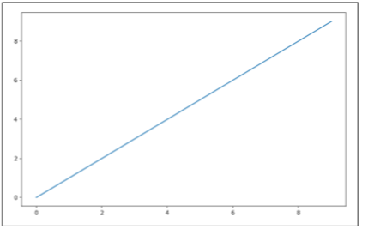
#plotting a line graph
In : plt.plot(data)
Out :

Slide 5
Subplots
Plots in matplotlib reside within a Figure object. You can create a new figure with plt.figure
In : fig = plt.figure()
In : ax1 = fig.add_subplot(2, 2, 1)
In : ax2 = fig.add_subplot(2, 2, 2)
In : ax3 = fig.add_subplot(2, 2, 3)

Slide 6
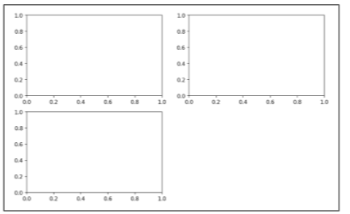
Out :

Slide 7
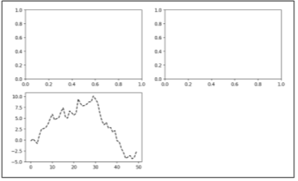
fig = plt.figure()
ax1 = fig.add_subplot(2, 2, 1)
ax2 = fig.add_subplot(2, 2, 2)
ax3 = fig.add_subplot(2, 2, 3)
In : plt.plot(np.random.randn(50).cumsum(), 'k--')
Out :

Slide 8
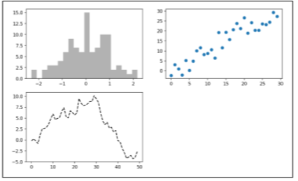
In : ax1.hist(np.random.randn(100), bins=20, color='k', alpha=0.3)
In : ax2.scatter(np.arange(30), np.arange(30) + 3 * np.random.randn(30))
Out :

Slide 9
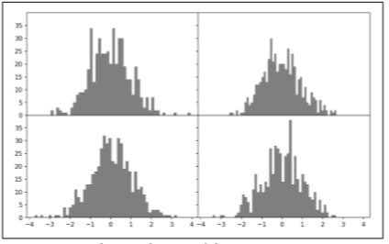
In [24]: fig, axes = plt.subplots(2, 3)
In [25]: axes
Out[25]:
array([[<matplotlib.axes._subplots.AxesSubplot object at 0x7fb626374048>, <matplotlib.axes._subplots.AxesSubplot object at 0x7fb62625db00>, <matplotlib.axes._subplots.AxesSubplot object at 0x7fb6262f6c88>], [<matplotlib.axes._subplots.AxesSubplot object at 0x7fb6261a36a0>, <matplotlib.axes._subplots.AxesSubplot object at 0x7fb626181860>, <matplotlib.axes._subplots.AxesSubplot object at 0x7fb6260fd4e0>]], dtype =object)

Slide 10
Colors, Markers, and Line Styles
Matplotlib main plot function accepts arrays of x and y coordinates and optionally a string abbreviation indicating color and line style. For example, to plot x versus y with green dashes, you would execute
ax.plot(x, y, 'g--')
ax.plot(x, y, linestyle='--', color='g')
There are a number of color abbreviations provided for commonly used colors, but you can use any color on the spectrum by specifying its hex code

Slide 11
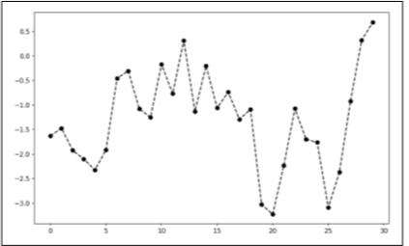
In [30]: from numpy.random import randn
In [31]: plt.plot(randn(30).cumsum(), 'ko--')
Out :
Line plot with markers

Slide 12
plt.plot(randn(30).cumsum(), color='k', linestyle='dashed', marker='o')
For line plots, you will notice that subsequent points are linearly interpolated by default. This can be altered with the drawstyle option

Slide 13
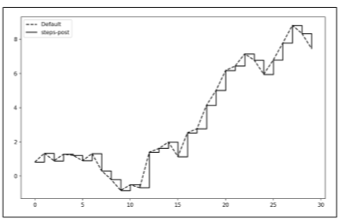
In : data = np.random.randn(30).cumsum()
In : plt.plot(data, 'k--', label='Default')
Out: [<matplotlib.lines.Line2D at 0x7fb624d86160>]
In : plt.plot(data, 'k-', drawstyle='steps-post', label='steps-post')
Out : [<matplotlib.lines.Line2D at 0x7fb624d869e8>]
In : plt.legend(loc='best')
Out :
Line plot with different drawstyle options

Slide 14
Ticks, Labels, and Legends
The pyplot interface, designed for interactive use, consists of methods like xlim, xticks, and xticklabels. These control the plot range, tick locations, and tick labels, respectively. They can be used in two ways:
• Called with no arguments returns the current parameter value (e.g., plt.xlim() returns the current x-axis plotting range)
• Called with parameters sets the parameter value (e.g., plt.xlim([0, 10]), sets the x-axis range to 0 to 10)

Slide 15
Adding legends
Legends are another critical element for identifying plot elements. There are a couple of ways to add one. The easiest is to pass the label argument when adding each piece of the plot:
In [44]: from numpy.random import randn
In [45]: fig = plt.figure(); ax = fig.add_subplot(1, 1, 1)
In [46]: ax.plot(randn(1000).cumsum(), 'k', label='one')
Out[46]: [<matplotlib.lines.Line2D at 0x7fb624bdf860>]

Slide 16
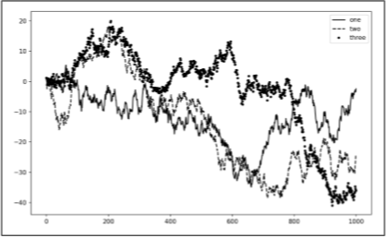
In : ax.plot(randn(1000).cumsum(), 'k--', label='two')
Out : [<matplotlib.lines.Line2D at 0x7fb624be90f0>]
In : ax.plot(randn(1000).cumsum(), 'k.', label='three')
Out : [<matplotlib.lines.Line2D at 0x7fb624be9160>]
# you can either call ax.legend() or plt.legend() to automatically create a legend.
In [49]: ax.legend(loc='best')
Out :
Simple plot with three lines and legend

Slide 17
Bar Plots
The plot.bar() and plot.barh() make vertical and horizontal bar plots, respectively. In this case, the Series or DataFrame index will be used as the x (bar) or y (barh) ticks
In : fig, axes = plt.subplots(2, 1)
In : data = pd.Series(np.random.rand(16), index=list('abcdefghijklmnop'))
In : data.plot.bar(ax=axes[0], color='k', alpha=0.7)
Out : <matplotlib.axes._subplots.AxesSubplot at 0x7fb62493d470>

Slide 18
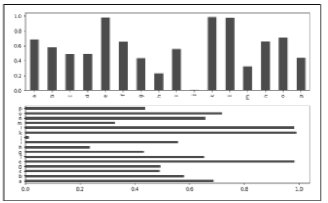
In [67]: data.plot.barh(ax=axes[1], color='k', alpha=0.7)
Out :
Horizonal and vertical bar plot

Slide 19
Histograms and Density Plots
A histogram is a kind of bar plot that gives a discretized display of value frequency. The data points are split into discrete, evenly spaced bins, and the number of data points in each bin is plotted. Using the tipping data from before, we can make a histogram of tip percentages of the total bill using the plot.hist method on the Series

